Slide 1
Online Shopping Website
Created By: Hozifa Zean Supervisor: Dr. O Kalu

Slide 2
Problem Statement
Online shopping website that allows customers to:
Browse, search for, and purchase products easily.
The website provides a seamless shopping experience, from product discovery to checkout, while ensuring security and reliability.

Slide 3
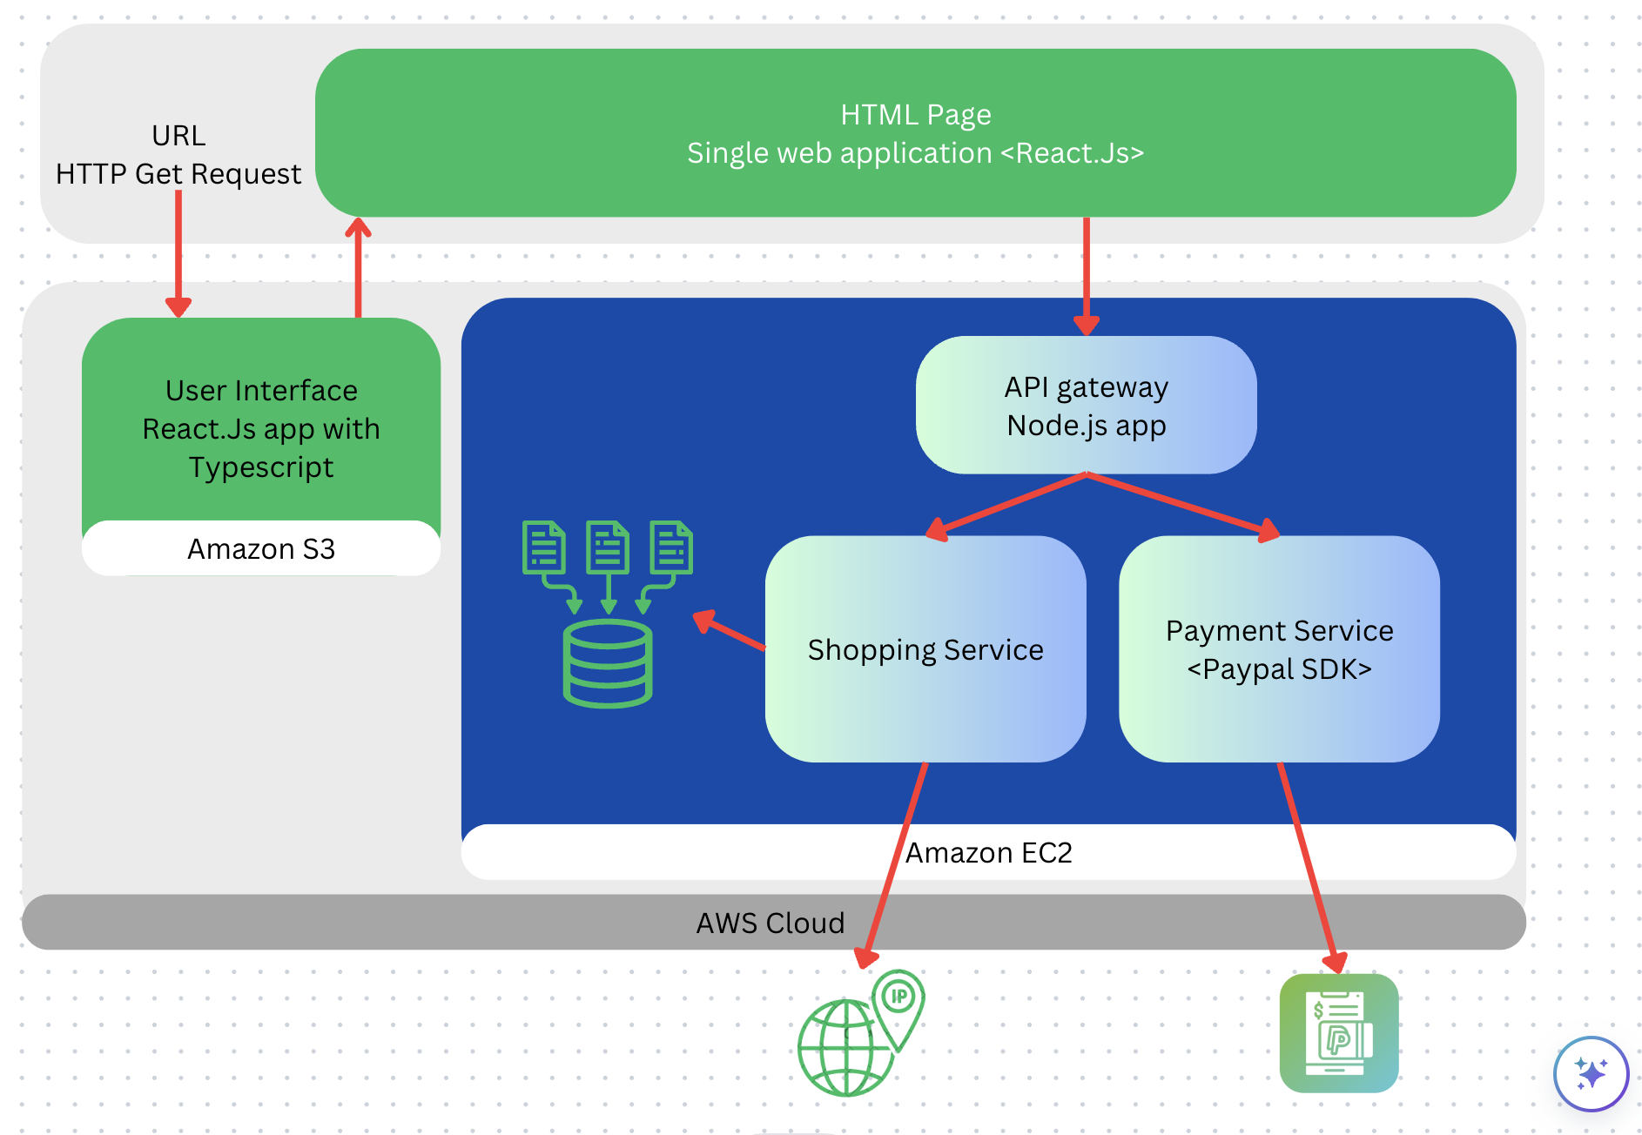
System Architecture

Slide 4
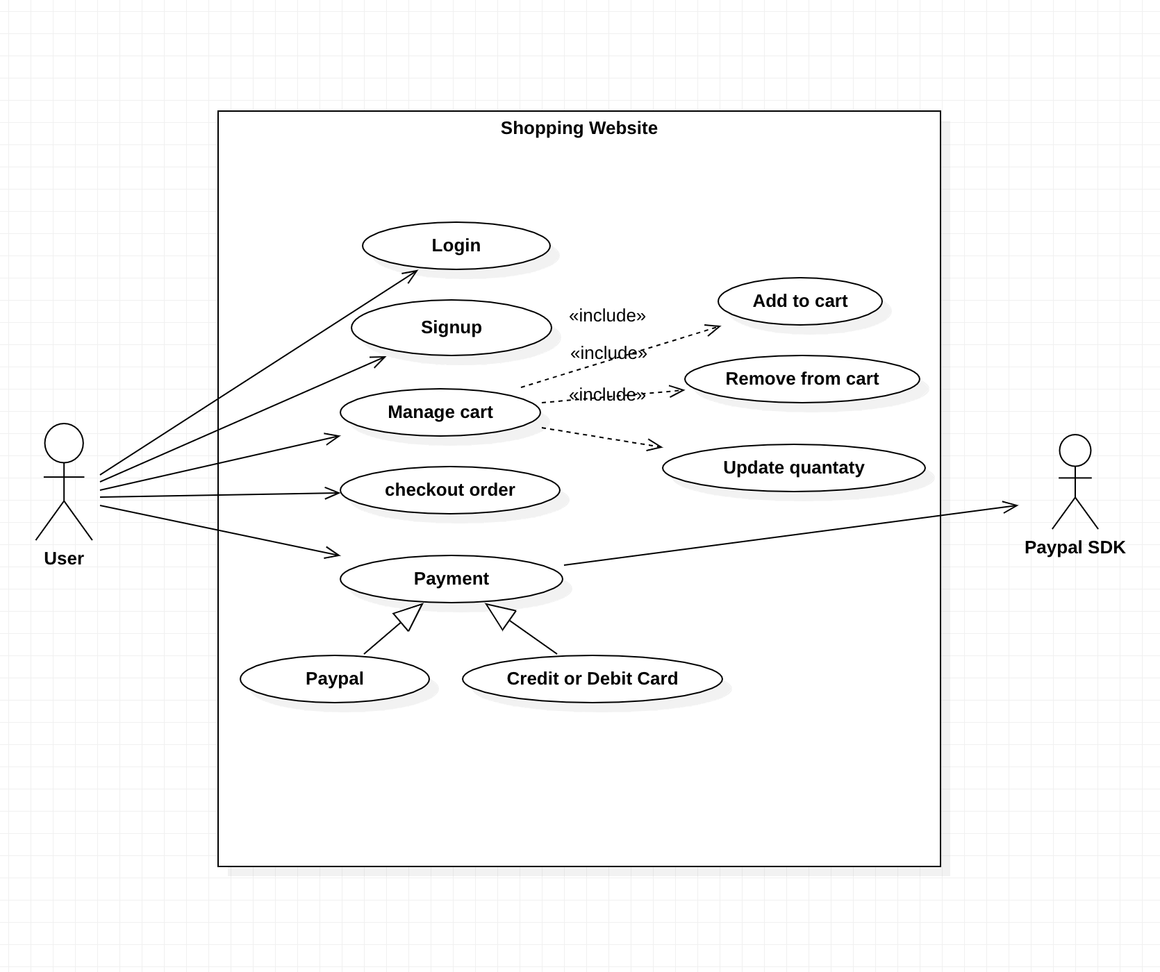
Usecase Diagram

Slide 5
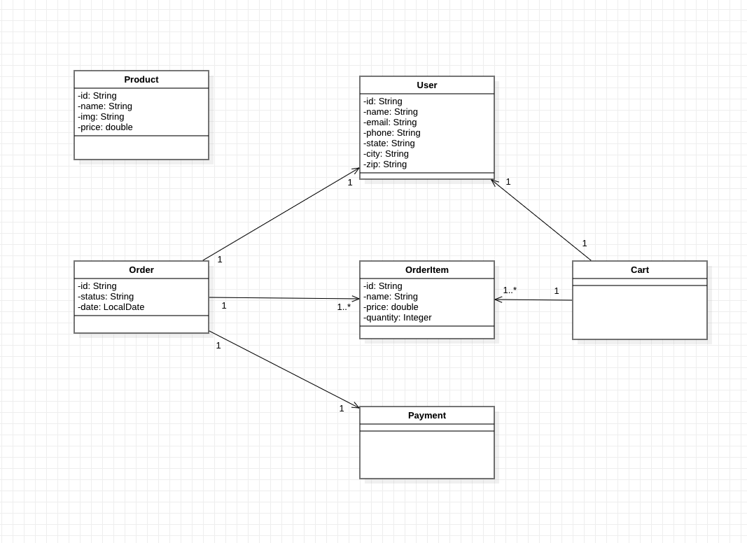
Class Diagram
Notes:
Consider talking about:
School and university
Project management
Civil and military construction and industry infrastructure
Computer software
State project

Slide 6
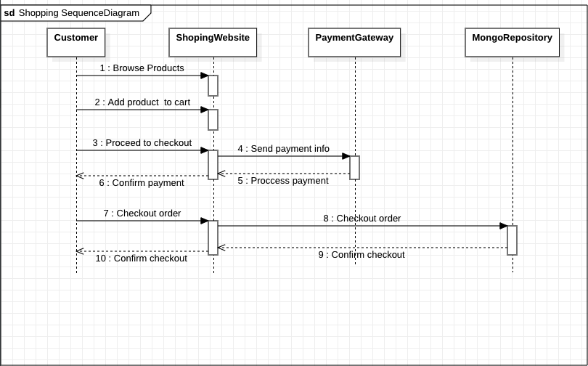
Sequence Diagram

Slide 7
Run Spring-Boot Service & Test cases Locally
Three test cases (Integration Test) using Rest- Assured.
Six test cases (Unit Test) using Junit dependency.

Slide 8
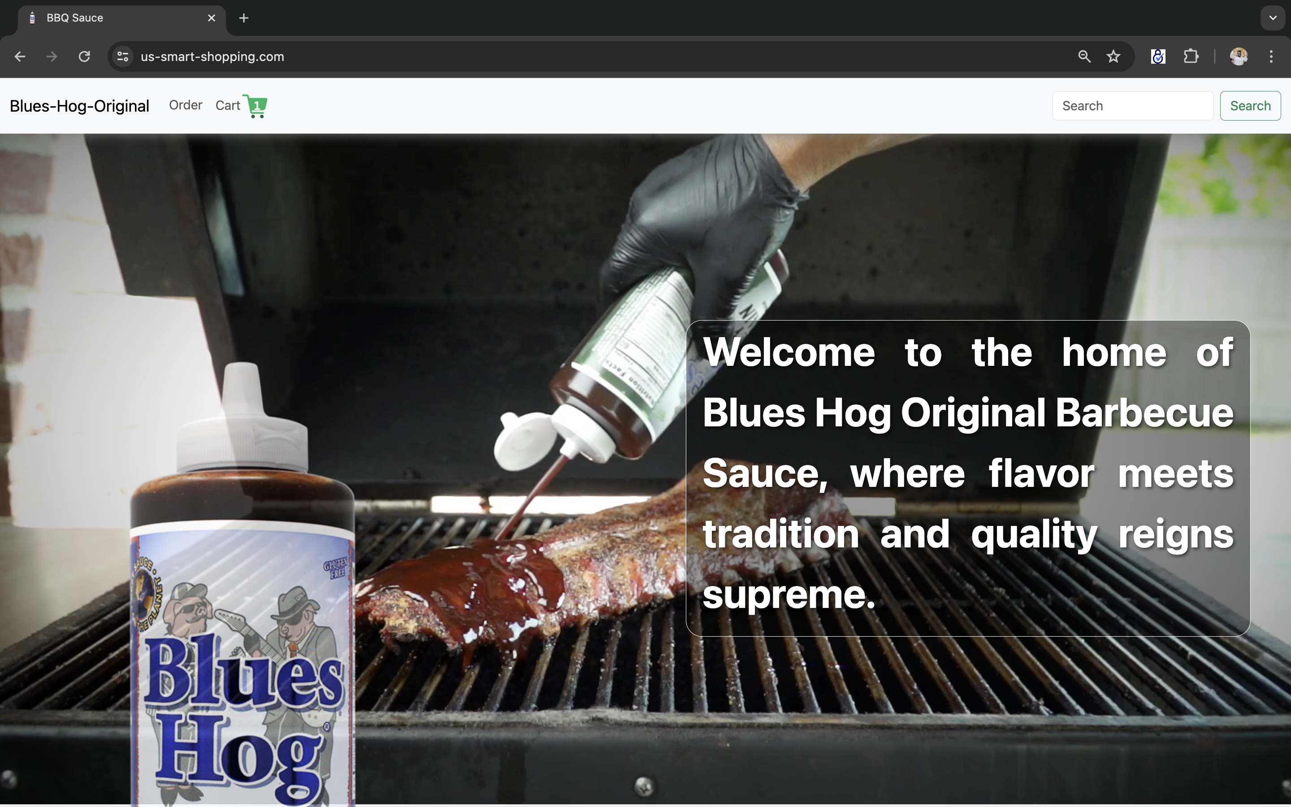
Responsive Design

Slide 9
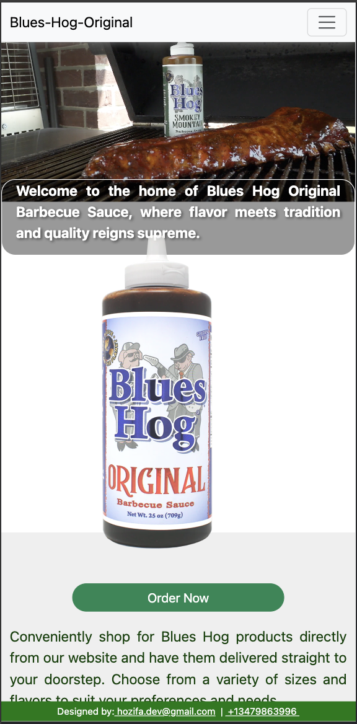
Responsive Design
Ensure the website is mobile-friendly and works seamlessly across different devices and screen sizes.

Slide 10
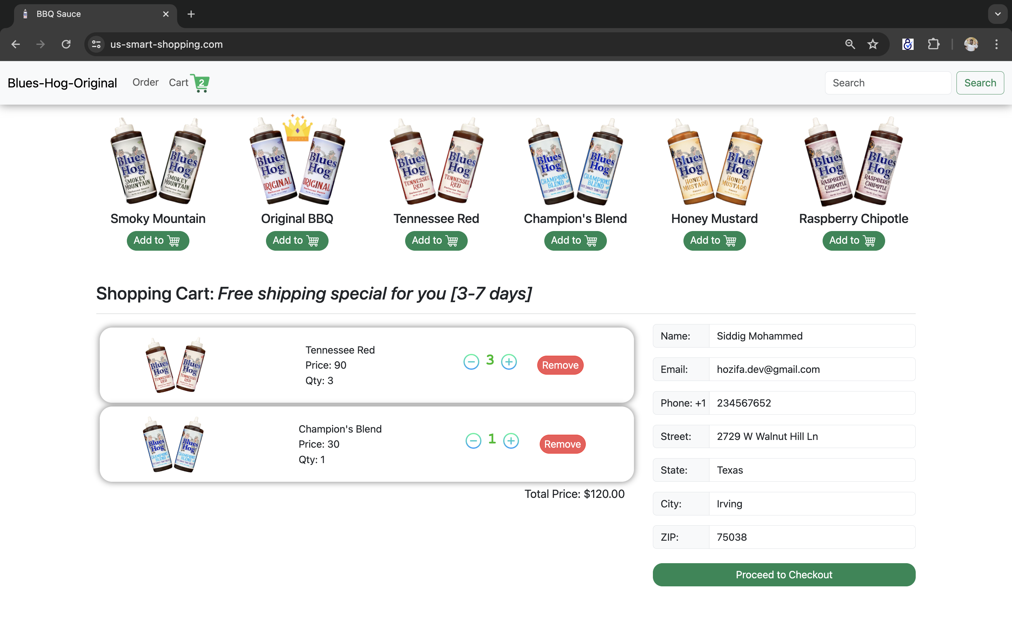
Shopping Cart

Slide 11
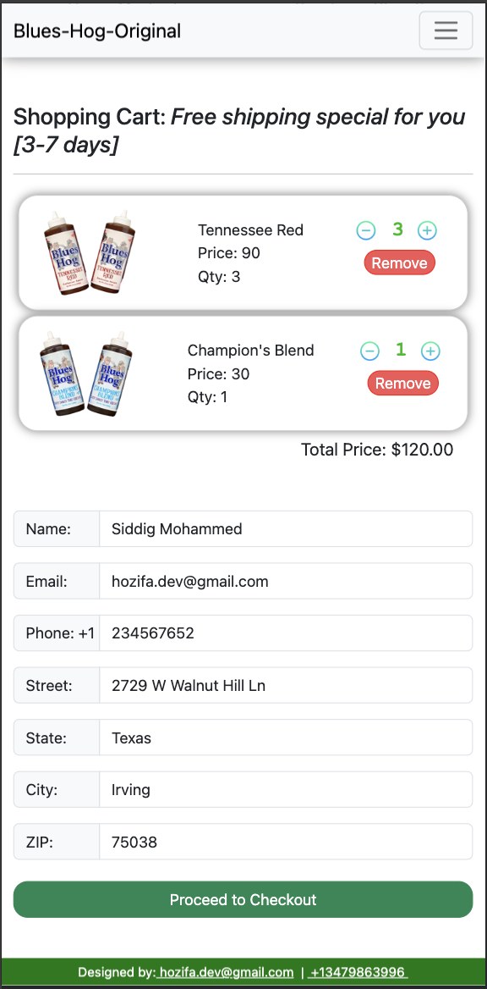
Shopping Cart
Allow users to add products to their cart, update quantities, and remove items. The cart display the total price and allow users to proceed to checkout.

Slide 12
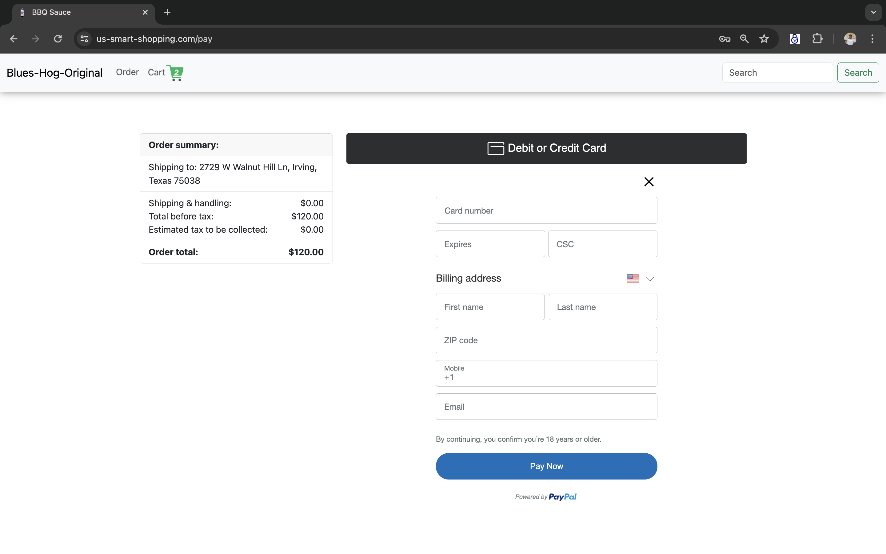
Checkout Process

Slide 13
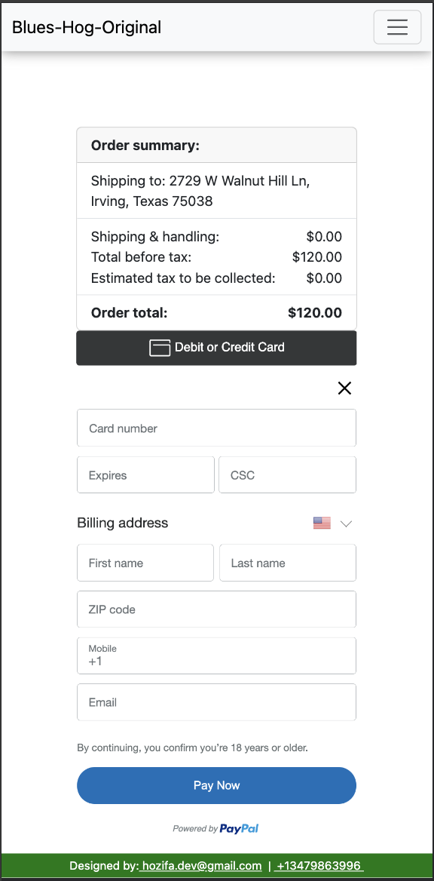
Checkout Process
Guide users through a smooth checkout process with options for shipping and payment. Provide secure payment gateways and order confirmation.

Slide 14
Thank You!

